Slide 1

Udemy Course Analysis
Harsh Misra
Delishya Mathew
Akanksha Jain

Slide 2
Business Model For Udemy
Revenues generated from the courses offered at Udemy online.
Increase in the number of subscribers for courses results in higher revenue generation.
Aligned the goal of the analysis to affect the business model directly.

Slide 3
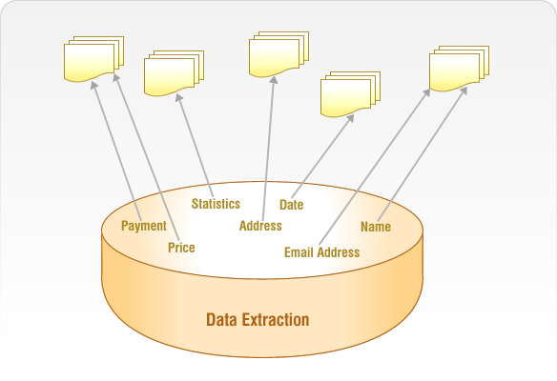




Process Flow
Data Extraction
Data Exploration
Data Cleaning
Data Analysis
Results and Recommendations

Slide 4
Characteristics of Data
Obtained data from data.world website.
Data concatenated based on the category of courses offered at Udemy.
Data has 3683 observation and 14 variables.
Data is from year 2011 ->2017.
Contains attributes such as :
Factor Variables
Course Category
Course Level
Price
Subscribers
Character Variables
Course Title
URL
IsPaid
Reviews
Published Lectures
Course Id
Course Duration
Numeric Variables

Slide 5
Data Cleaning
Conversion to Numeric Variables
Conversion to Factor Variables
Data conversion
Data Variables Price, Number of Subscribers, Number of Reviews , Number of Published Lectures
Data Variables Instruction Level, Category isPaid
Price “Free” -> 0
Published_Time -> Published_Year
Removal of NA’s

Slide 6
Research Question
What are the Factors which affect the number of subscribers for courses in Udemy ?

Slide 7
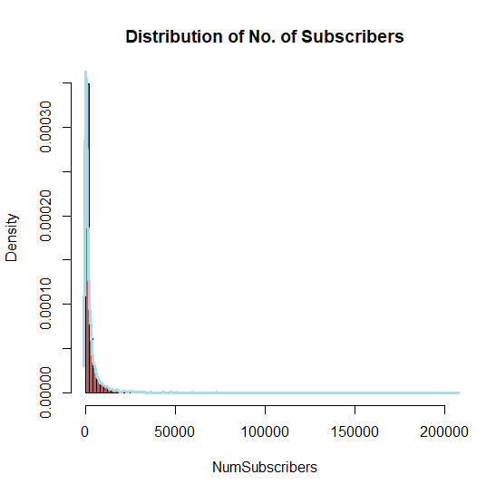
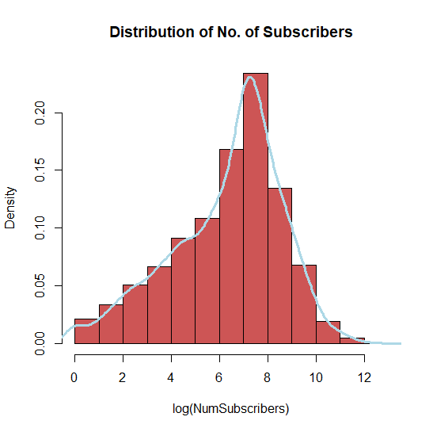
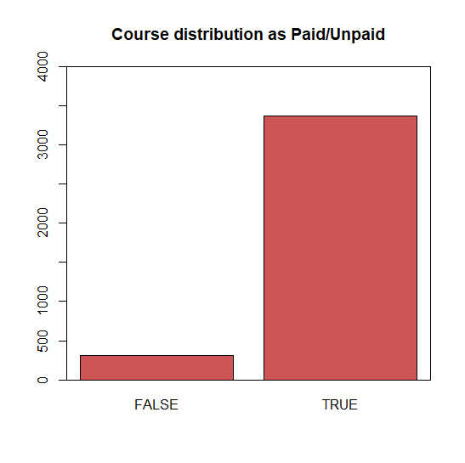
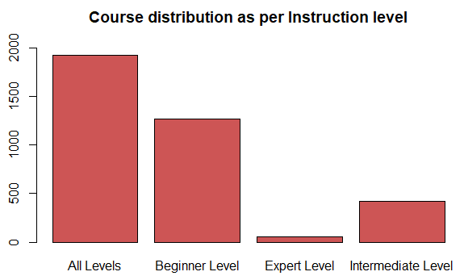
Univariate Analysis

Slide 8
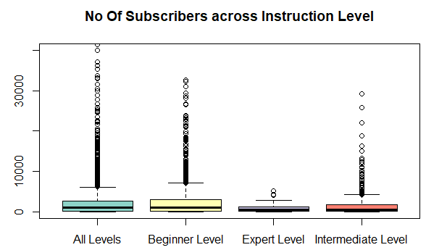
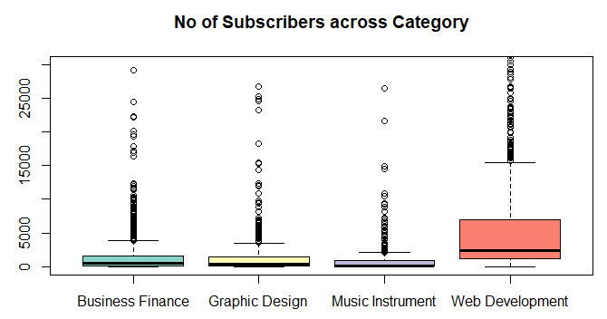
Bivariate Analysis
More subscribers across All and Beginner level
More subscribers for Web Development Category

Slide 9
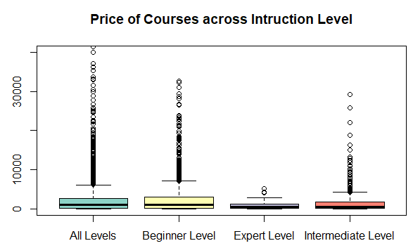
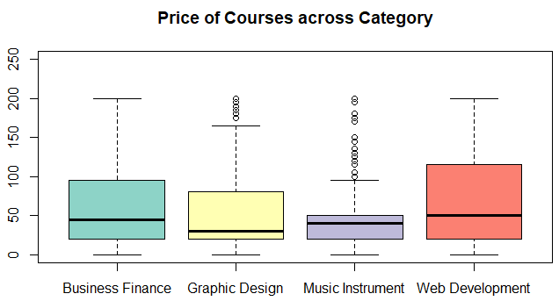
Bivariate Analysis
All Levels and Beginner Levels are more expensive
Web Development courses are more expensive

Slide 10
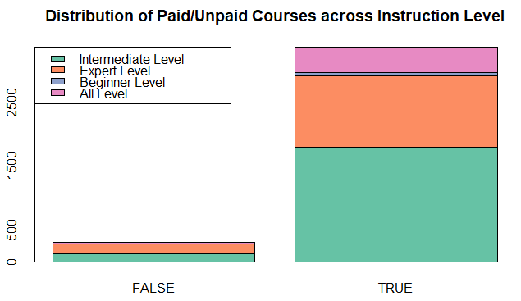
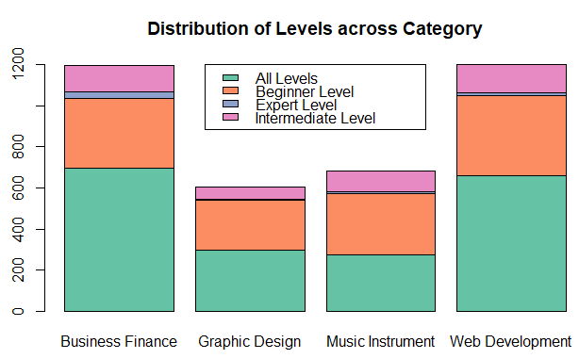
Bivariate Analysis

Slide 11
Hypothesis 1
H0 : The average number of Subscribers for Expert Level Courses is same as Other Level Courses
HA : The average number of Subscribers for Expert Level courses is less than Other Level Courses
T Test
p value of 0.00000000000000022
The average number of Subscribers for Expert Level courses is less than Other Level Courses holds true

Slide 12
Hypothesis 2
H0 : The average number of subscribers is same across all categories.
p value of 0.0000000000000002
Anova Test
HA : The average number of Subscribers for Web Development Courses is more than Other Category Courses
The average number of Subscribers for Web Development course is higher as compared to other courses.

Slide 13
Hypothesis 3
H0 : The mean course price is same across all Course Categories.
HA : The mean course price is more for Web Development courses.
Anova Test
p value of 0.0000000000000002
The mean price of course is more for Web Development courses as compared to other courses.

Slide 14
Regression Modelling Model 1
Dependent Variable
Number of Subscribers
Independent Variable
Category, Number of Lectures
Adjusted R Squared value
26.98%
Removing the outliers also did not give substantial difference in the Adjusted R squared value. (Scope for improvement)

Slide 15
Model 2
Dependent Variable
Number of Subscribers
Independent Variable
Category, Price, isPaid, Course Level
Adjusted R Squared value
34.68%
Removing the outliers increased the Adjusted R squared Value to 34.73%

Slide 16
Inferences from the model
Category
Number of Lectures
Subscribers
Subscribers
Price
isPaid
Level of Course
Category

Slide 17
Recommendations
Introduce new Web Development courses.
Introduce new paid courses in the “All Level” and “Beginner Level” categories.
Suggestions
Convert unpaid courses to paid courses after attaining a significant number of subscribers.

Slide 18
Limitations
Analysis done considering the list price not the discounted price
Price is a skewed variable.
Some variables such as “instructor details” and “course rating” were not present in the dataset
The recommendations and results can not be generalized for all online learning portals.

